Slide 1


Capstone Project
Yvesna MARCELIN
yvesnamarcelin48@gmail.com

Slide 2

Predicting Category of Job
Machine Learning approch (NLP)
Thursday, September 30th 2021

Slide 3

Agenda
Summary
01
Introduction
Define the subject
Context
02
Methodology
Data source
Relevant Analysis
03
Model
Machine Learning
04
Conclusions
Limits
Other Prespective

Slide 4
Introduction
Define the subject and Context
To keep up with the needs and requirements of the job market, our young academics and professionals are looking for information and advices. Because it's become more and more difficult to access the job market.
In addition to the evolution of technology and the different problems that young people are facing, the processes of offers and recruitments are constantly evolving.
Therefore, this study was conducted on job offers, job titles of the last few years, for young graduates and professionals seeking orientation.

Slide 5





Methodology
Naturel Language Processing
Using NLP to analyze and process our text data from human language
Data Cleaning
Using NumPy and Pandas to start data cleaning
Model
Using Classification model in Machine Learning.
Data Source
The data used are collected from Jobpaw
Conclusion
Summarize the project and present new perspective

Slide 6
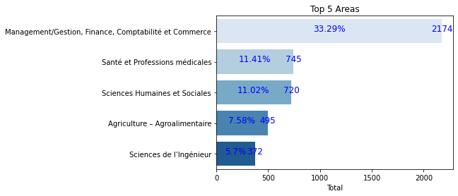
Results
The domains of study most in demand
69%
The percentage of the most requested domains is 69%.

Slide 7
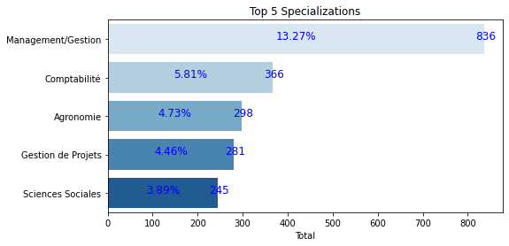

Results
The Specializations most in demand
51%
These specializations represent 51% of the most requested

Slide 8
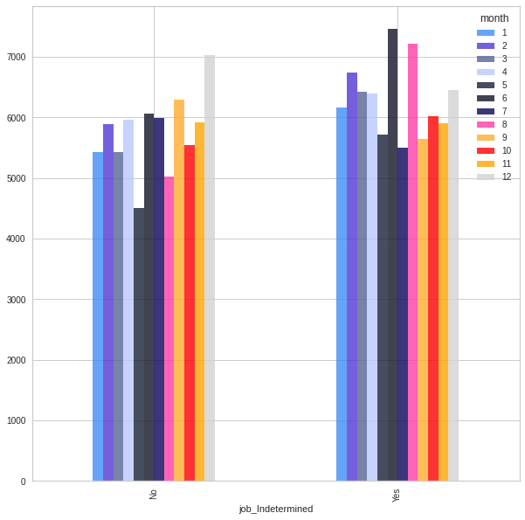

Results
Indeterminate job per month
Here we made a ranking for the jobs determined over a period of time and those not determined. We have done a chi-square test to see if there is a significant difference. The month of December gives a lot more determined time jobs and in June the non determined ones.

Slide 9
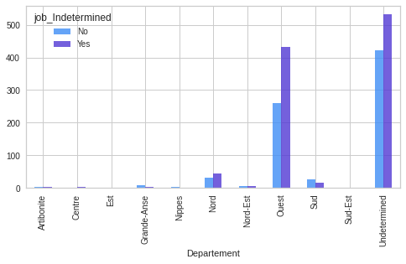

Results
Indeterminate Job per department
This is a ranking by department. we have a significant difference. The western department offers more full time work. The other department is not mentioned.

Slide 10
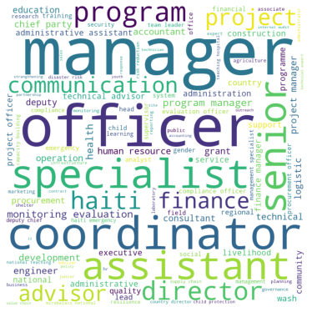

The most recurrent job title terms
The job titles do not allow any adequate classification. Some are same but different in their description. So we made a Worl Cloud in order to see the most repeated titles.

Slide 11
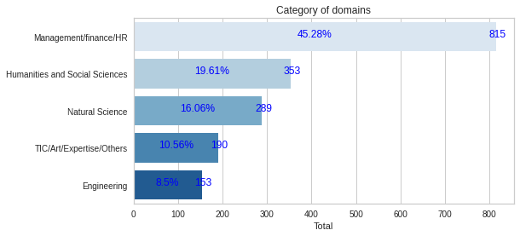

Classification of categories of domains
By classifying the domains, Management remains the most requested domain, followed by Human and Social Sciences, for example Education Science.

Slide 12

Model
Some machine learning models
We will use machine learning to find a model that can predict job category classes.
We will take into account the most appropriate models for this classification. The score and learning speed, time are assets to consider.
Names | Scores | Times
Logistic Regression | 0.731481 | 17.898961
Ridge Classifier | 0.781481 | 2.123926
RandomForestClassifier | 0.672222 | 4.995218
KNeighborsClassifier | 0.672222 | 4.221043

Slide 13
Model
Some machine learning models
We build our model with the classification we made with the domains of study.
The model we have chosen here is the ridge classifier witch has a good accuracy, of 78%. And good score for each category.
Engineering __ 0,88
Humanities and Social Sciences __ 0,71
Management/Finance/HR __0,83
Naturel Science __0,77
TIC/Art/Expertise/Others __0,57

Slide 14
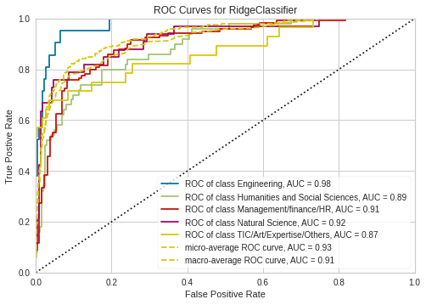
Classification ROC Curve and AUC
Here we have a ROC Curve (Receiver Operating Characteristic Curve). It is a graph showing the performance of our classification model by visualization. AUC (Area under the ROC Curve) provides an aggregate measure of performance across all our possible classification.

Slide 15
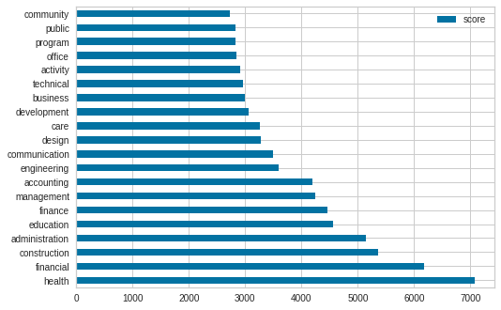
Results
Here we have the top 20 of the words that can classify a job in our model. Like if the machine see the word health, it can predict if it belongs to the Natural Science, Humanities and Social Science.

Slide 16
Conclusion and Limits
In short, the objective of this project was to classify the different domains and then develop a machine learning model to predict which category of domains the machine will be predicting with by using the words passed as commands.
It should be noted that the work here is taken exclusively from the webscrapper data on jobpaw. Therefore some are misattributed. but also the job titles, domains, specialties and others are in English and French. With Natural Language Processing, using stop word and lemmatize, we were able to normalize the document and work with the English data. So our model is made with only this kind of data.

Slide 17
References / Appendices
Link GitHub for the Project: https://github.com/Yvesie67/Capstone_Project#capstone_project

Slide 18

For any more Question:
yvesnamarcelin48@gmail.com

Slide 19

Results
The top 5 of domains most in demand
Management/Gestion
Finance, Comptabilite et Commerce
33.29%
69%
These domains represent 69% of The most requested
11.41%
Santé et profession medicals
Sciences Humaines et Sociales
11.02%
7.58%
Agriculture/Agroalimentaire
Sciences de l'Ingenerie
5.7%

